Slide 1

Automation Testing
Agaram Technologies
Murali R
Trainee - Software Engineer
Department of Testing

Slide 2

Automation Testing
Automation Testing

Slide 3
Agenda
Agenta
Drawbacks of Manual Testing
Automation Testing
Benefits
Tools
Real Time Execution

Slide 4
Drawbacks of Manual Testing
Drawbacks of Manual Testing
Humans may make mistake on flow
Executing Testcases manually is very time consuming job.
It need more resources
Regression Testing is not efficient
Adding large amount of data is not possible on short duration
Less Accuracy

Slide 5
Automation Testing
Automation Testing
Testing the application by using Automation Tool
-- Writting Test Case for all CRS
-- Converting Test Cases into Test Scripts
-- Executing the Test Scripts on Automation Tool
-- Auto Generating Test Case Reports
Test Case
Test Script
Execution

Slide 6


Tools
Tools
^{Selenium}
Eclipse

Slide 7
ECLIPSE
Eclipse
Integrated Development Environment
Open Source Software
Automation Script writing tool

Slide 8


Selenium
It is an open-source automation tool
Use Multiple language
Java
C#
PHP
Python
Perl
Ruby
Use Multiple Browser
Google Chrome
FireFox
Safari
Internet Explorer
kill

Slide 9
Who can use selenium
DEVELOPER
Unit Testing
SELENIUM
TESTER
Regression Testing
CUSTOMER
Acceptance Testing

Slide 10
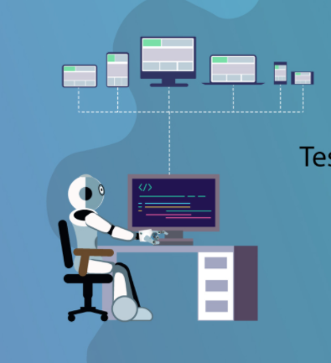

Merits
Merits
Eliminate Human Error
Execute TestCases parallelly
Schedule our Testcase Execution
Easy Regression Testing
Earlier detection of defects
Reduced Business Costs & Better Utilization Of Manpower
Faster Delivery to Customer
-- Eliminate Human Error
-- Execute TestCases parallelly
-- Schedule our Testcase Execution
-- Easy Regression Testing
-- Earlier detection of defects
-- Reduced Business Costs
-- Faster Delivery to Customer

Slide 11
Real Time Execution
Task
Regression Test

Slide 12
TASK
Create User Role As Manager
Create Password Policy for Manager
Giving All Screen Rights
Giving All Control Rights
Adding Data in all screen of Base Master
Giving data with space in front of value in all text field
Verified and Creating Report for 18 TestCases
Regression Test

Slide 13
Demerits
DrawBacks of Automation Testing
Can not find GUI related bugs
Allignment issue not possible
Can not test Report
Only Possible for Web Base Application
Need to spend lot of time for preparing script

